Slide 1

UNIT -1 IMPORTANCE AND SCOPE OF MARKETING

Slide 2
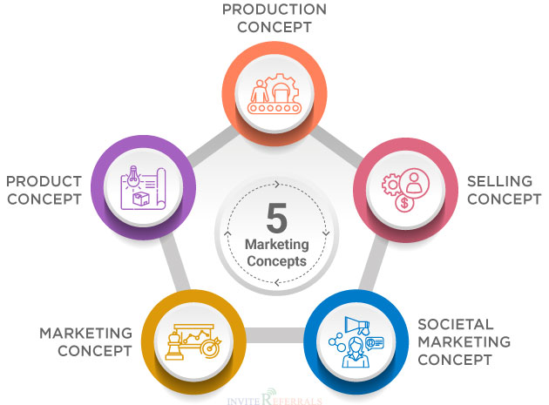
CONCEPTS OF MARKETING

Slide 3
Production Concept-This concept was based on the assumption that customers are primarily interested in products which are accessible and affordable.
Product Concept-The product concept is based on the assumption that customers will be more inclined towards products that are offering more quality, innovative features and top-level performance.
Selling Concept- It believes that customers will be buying products only when the product is aggressively marketed by the company. It does not focus on building relationships with customers, and ensuring customer satisfaction is also not deemed necessary.
Marketing Concept-A marketing concept places the centre of focus on the customer. All the activities that are undertaken by an organization are done keeping the customer in mind.
Societal Marketing Concept-This is the most advanced form of the marketing concept. Here the focus is on needs and wants of the customer as well as ensuring the safety of the customer and society first.

Slide 4
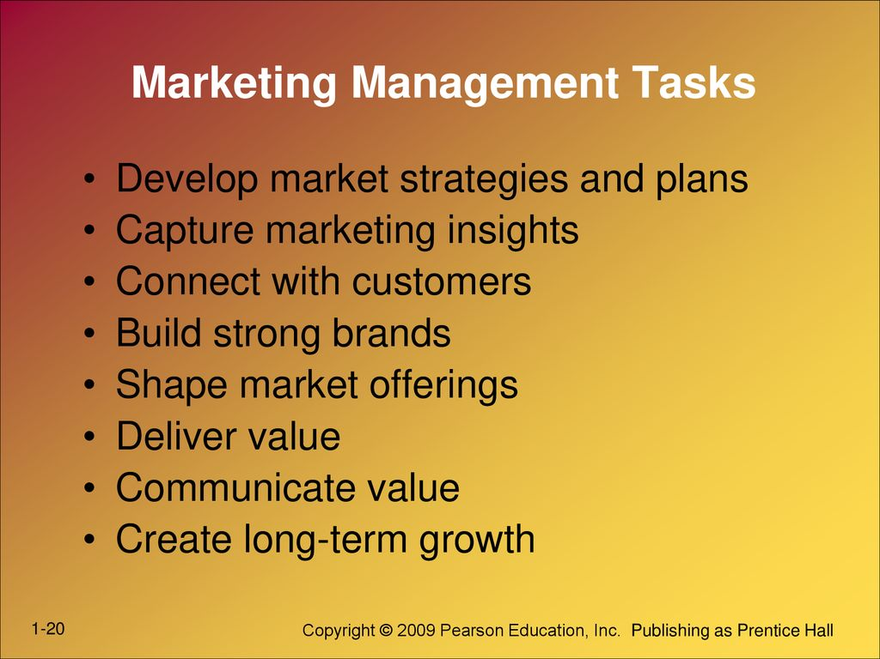
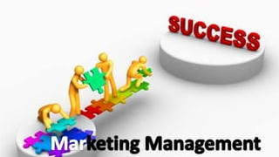

Slide 5
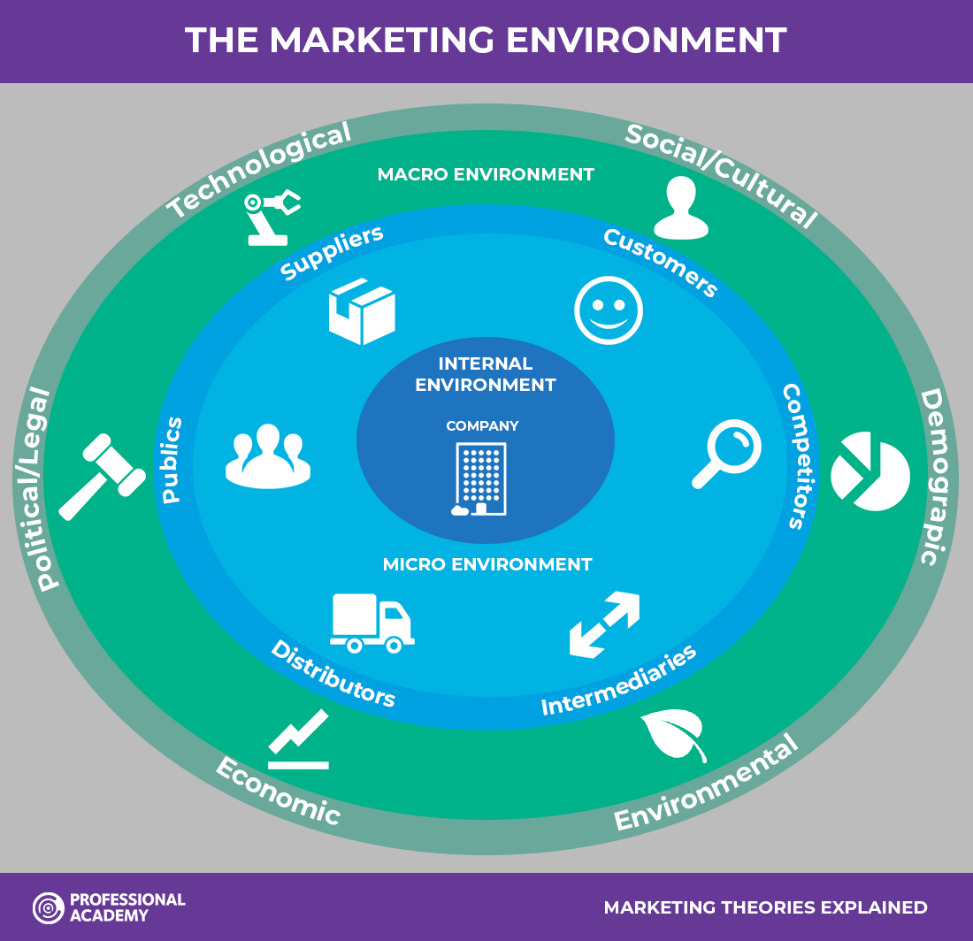

Slide 6
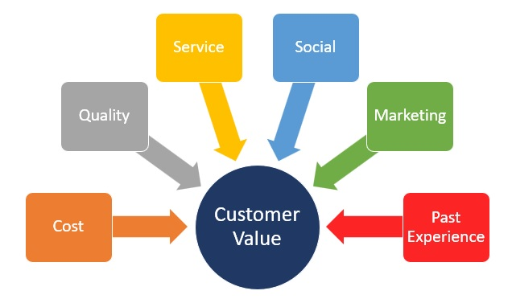
Marketing & Customer Value
Customer Value Marketing is a customer's perception of the value of your product or service. The benefits the products and services provide to the target market, or the value of the money they provide.

Slide 7
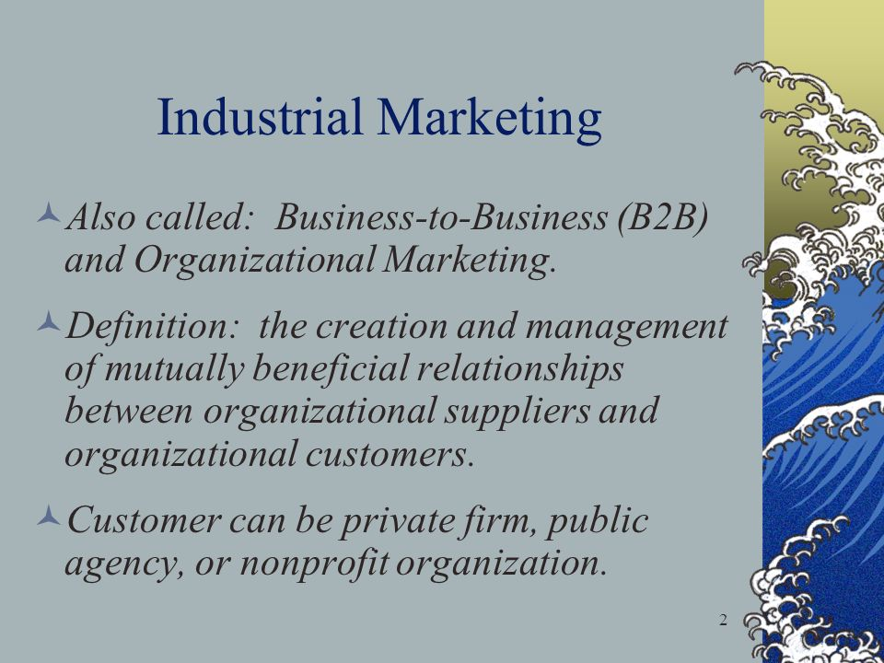
Industrial Marketing

Slide 8
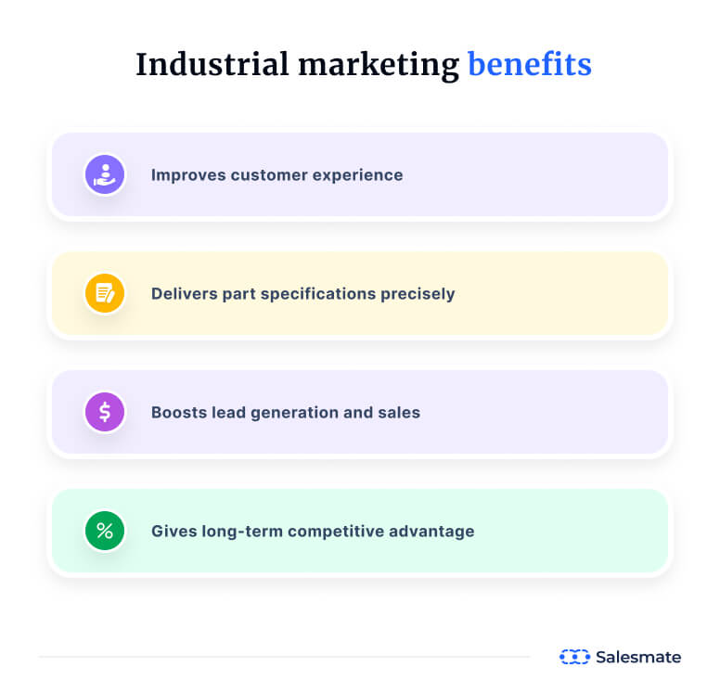

Slide 9
Services Marketing
Service marketing is simply the process of promoting and selling a service or an intangible good to a specific group of people. It is a new way of marketing that has become very popular and helps companies all over the world promote their services.
Example- Uber
Uber is an on-demand transportation technology that connects driver-partners with riders. For riders, Uber is a great service that helps them get exactly where they need to go faster while drivers benefit from their time behind the wheel and earn some income. The core value here is flexibility for everyone involved (rider and driver).
However,Uber also works on building credibility and trust. It builds credibility with rider built-in reviews, and trust with safety guarantees for both riders (driver screenings and safety tools) and drivers (incident response teams, insurance, and other safety tools and services).

Slide 10
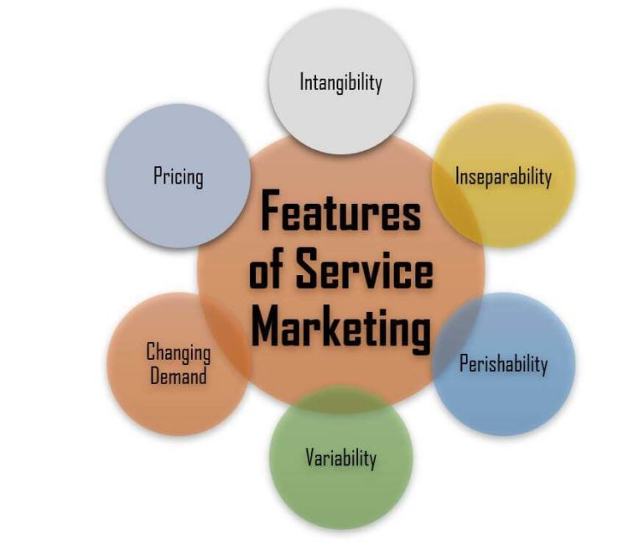

Slide 11
Intangible - the nature of services is that you can not see, smell, or touch them. So brands have to build a lot of trust before the sale ever happens because it’s hard for a customer to sample it.
Perishable - once the customer receives the service, it’s gone. That’s why brands need to come up with effective marketing strategies to stay top of mind and remind their customer base of the experience.
Inseparability-When purchasing a product, most customers can separate the product from the staff member who provides it. However, when purchasing a service, customers commonly purchase a service at the time they want to consume them.
Variability-It means a lack of consistency and measures how much data or experiences vary. When purchasing services, there is greater variability there will always be changes in the experience of the same service provided by different vendors.
Changing demand-The demand for services has wide fluctuations and may be seasonal.
Pricing -Quality of services cannot be standardized. The pricing of services are usu­ally determined on the basis of demand and competition.

Slide 12
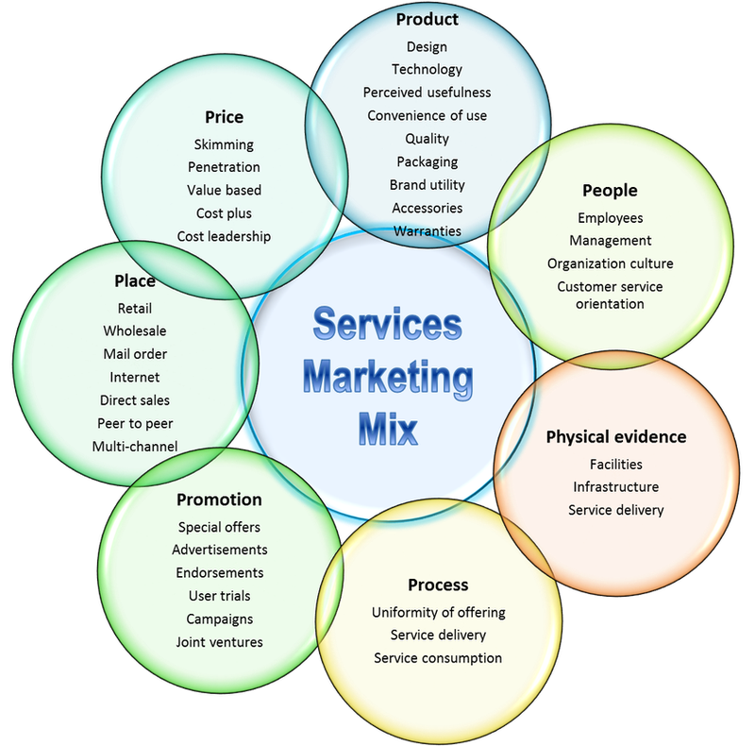

Slide 13
Aspect | Service Marketing
Product | It focuses on selling intangible services consumed immediately and cannot be owned.
Price | Uses subscriptions, hourly rates, or bundled services reflecting immediate consumption.
Place | About accessibility and convenience, often digitally or at a comfortable location.
Promotion | Emphasizes benefits, experience, and value, using testimonials and case studies.
People | People play a crucial role as service providers, impacting customer experience.
Process | Vital to ensure efficient and satisfactory service delivery, often in real-time.
Physical Evidence | Includes the environment and elements that support and enhance the service experience.

Slide 14
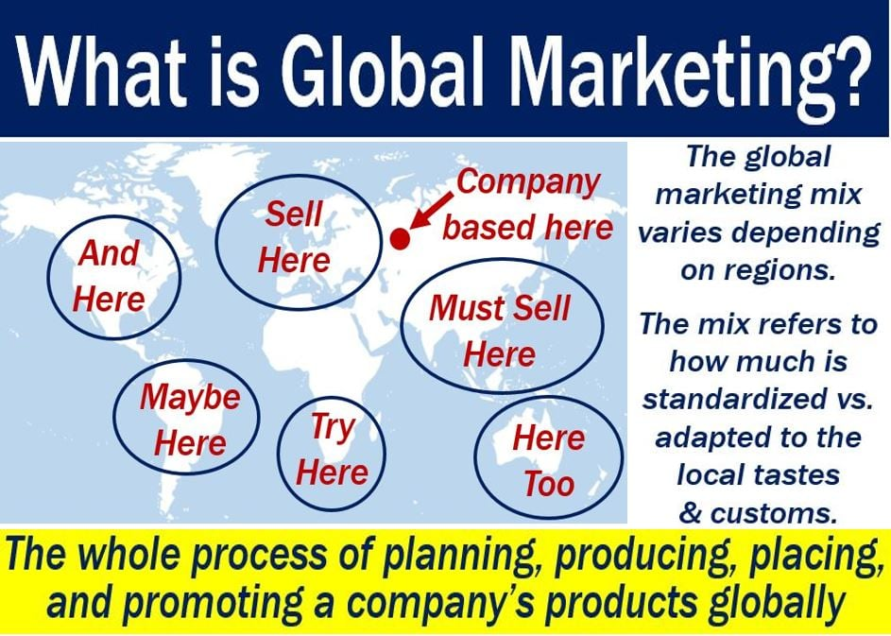
Global Marketing

Slide 15
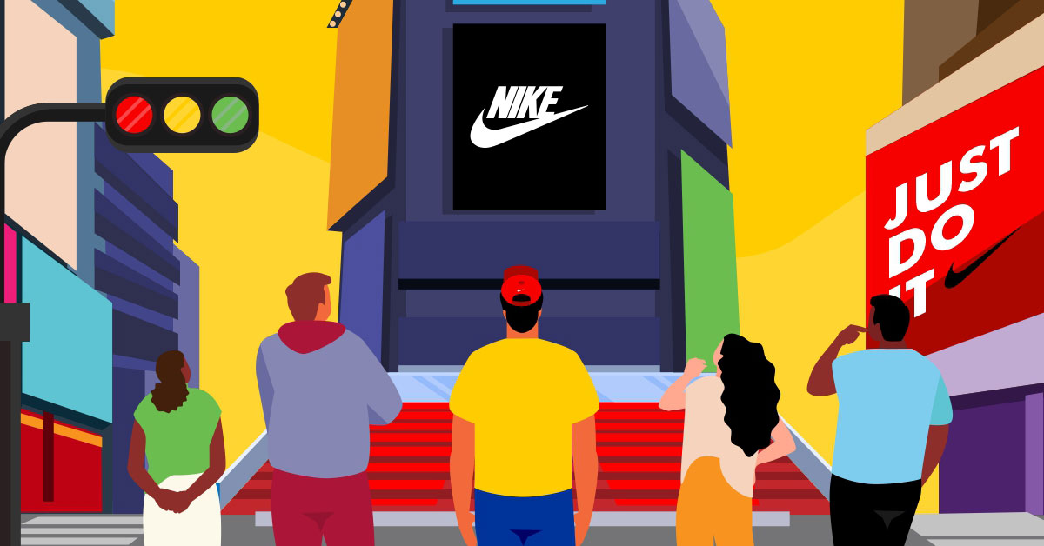
Example of Global Marketing
Nike
Nike has grown to become one of the most recognized brands on the planet through a combination of global marketing tactics, and strategic international sponsorships and partnerships that appeal to audiences around the world.

Slide 16
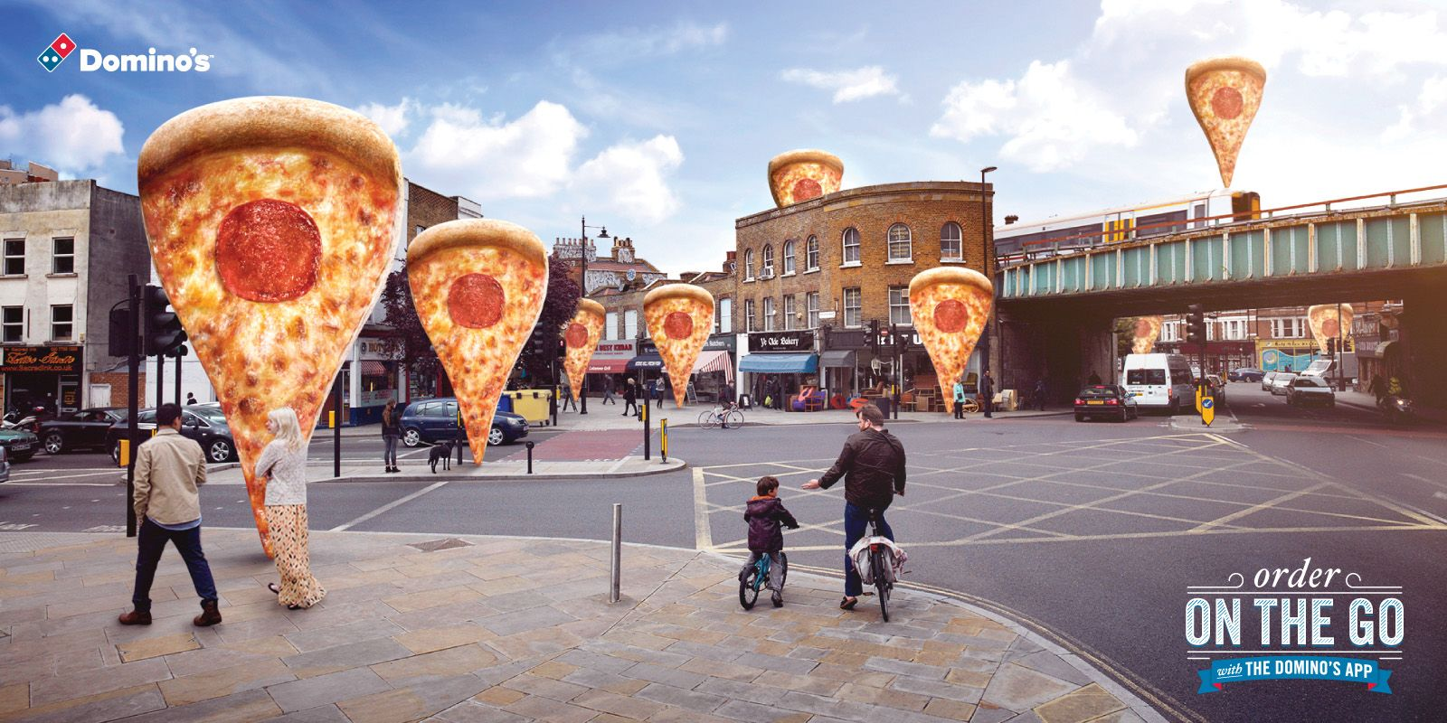
Domino’s
Depending on where you live, Domino’s has menu items (including toppings, sauces, bread, and cheeses) that are available for various global markets. For instance, in Asia, Domino’s offers a variety of seafood options for toppings.

Slide 17
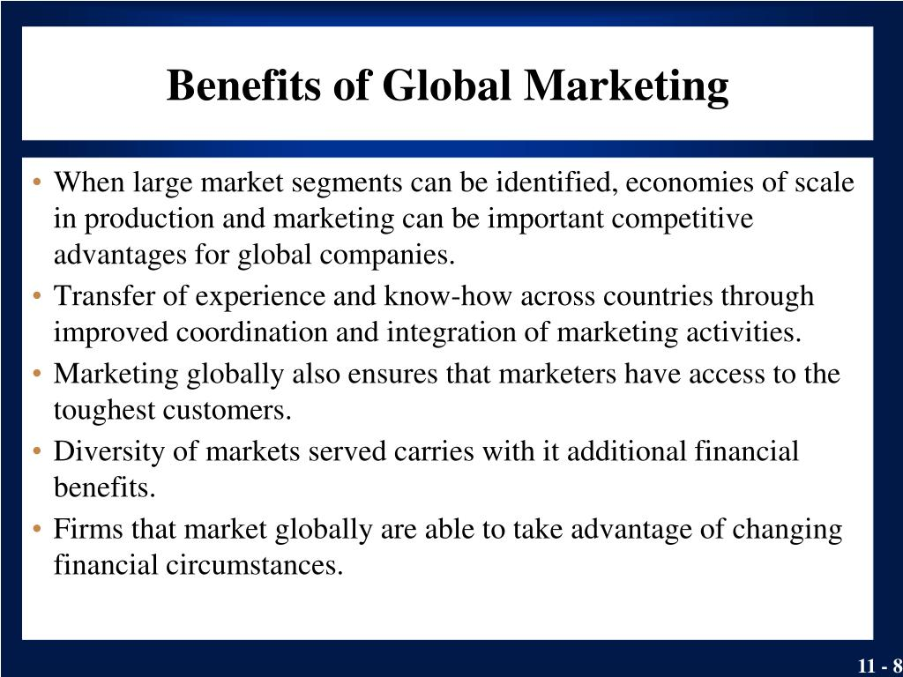

Slide 18
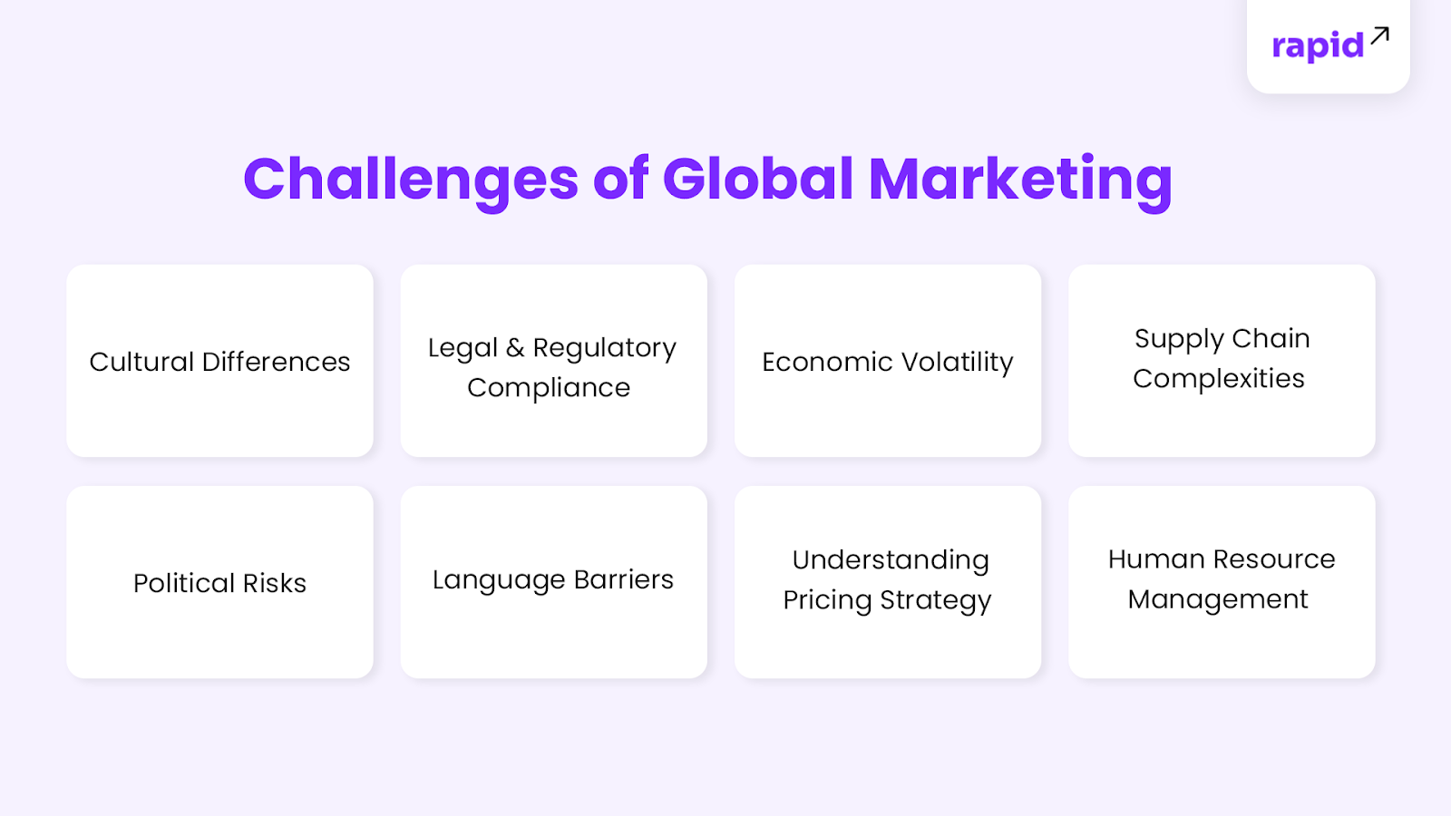

Slide 19
1. Cultural Differences-What resonates with a Western audience may not appeal similarly in India. A classic example is McDonald's, a global fast-food chain, which had to adapt its menu to cater to Indian tastes and cultural preferences, introducing items like the Aloo Tikki burger to resonate with vegetarian preferences.
2. Legal and Regulatory Compliance-When companies expand into new markets, they encounter diverse legal and regulatory environments. Each country boasts its own set of rules, regulations and standards.
3. Economic -Economic uncertainty can profoundly influence market entry decisions and profitability.
4. Supply Chain Complexities-Managing a global supply chain mandates strategic planning and coordination. Different regions come with their own sets of tariffs, customs duties and regulations, potentially affecting product pricing and availability.

Slide 20
5. Political Risks-A change in political leadership, governmental policies, or international relations can impact trade tariffs, regulations and business operations.
6. Language Barriers-While fundamental to effective communication, language can become a significant barrier when resonating with local audiences.
7. Understanding Pricing Strategy-Pricing isn't merely about converting currencies. It's about understanding local economic conditions, competitive landscapes and consumer expectations
8. Human Resource Management-The intricacies of managing a global team are manifold. Differences in labour laws, cultural work ethics and expectations pose challenges for hiring, training and retention.

Slide 21


